Slide 1
Android - Lecture 3

Slide 2
homework

Slide 3
Other Libraries:
https://github.com/codepath/android_guides/wiki/Must-Have-libraries

Slide 4
3th lecture Agenda
Layout elements (ListView, GridView)
Persistent storage
App debugging process

Slide 5


Layout
List View
Displays a scrolling single column list.
Grid View
Displays a scrolling grid of columns and rows.

Slide 6
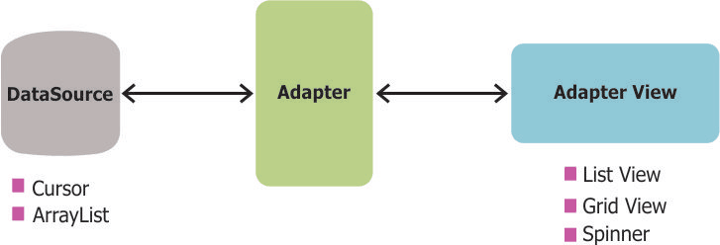
Adapter

Slide 7
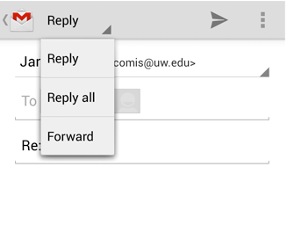
Spinner
Spinner allows you to select an item from a drop down menu

Slide 8
Adapter
An Adapter object acts as a bridge between an AdapterView and the underlying data for that view. The Adapter provides access to the data items. The Adapter is also responsible for making a View for each item in the data set.
An adapter is responsible for retrieving data from the data set and for generating View objects based on that data. The generated View objects are then used to populate any adapter view that is bound to the adapter.

Slide 9
How Do Adapter Views Work?
Adapter views can display large data sets very efficiently. For instance, the ListView and GridView widgets can display millions of items without any noticeable lag while keeping memory and CPU usage very low. How do they do that? Different adapter views follow different strategies. However, here's what most of them usually do.
They render only those View objects that are either already on-screen or that are about to move on-screen. This way, the memory consumed by an adapter view can be constant and independent of the size of the data set.
They also allow developers to minimize expensive layout inflate operations and recycle existing Viewobjects that have move off-screen. This keeps CPU consumption low.

Slide 10
Creating an ArrayAdapter
To create an adapter, you need the following:
a data set
a resource file containing the layout of the generated View objects
Additionally, because the ArrayAdapter class can only work with strings, you need to make sure the layout of the generated View objects contains at least one TextView widget.

Slide 11
Create the Data Set
The ArrayAdapter class can use both arrays and List objects as data sets.
String[] cheeses = {
"Parmesan",
"Ricotta",
"Fontina",
"Mozzarella",
"Cheddar"
};

Slide 12
Create the Resource File
<?xml version="1.0" encoding="utf-8"?>
<LinearLayout xmlns:android="http://schemas.android.com/apk/res/android"
android:orientation="vertical" android:layout_width="match_parent"
android:layout_height="match_parent”>
<TextView
android:layout_width="wrap_content"
android:layout_height="wrap_content"
android:textAppearance="?android:attr/textAppearanceLarge"
android:text="Large Text"
android:id="@+id/cheese_name" />
</LinearLayout>

Slide 13
Create the Adapter
ArrayAdapter<String> cheeseAdapter =
new ArrayAdapter<String>(this,
R.layout.item,
R.id.cheese_name,
cheeses
);
In your activity, create a new instance of the ArrayAdapter class using its constructor. As its arguments, pass the name of the resource file, the identifier of the TextView, and a reference to the array. The adapter is now ready.

Slide 14
Creating a List
To display a vertically scrollable list of items, you can use the ListView widget. To add the widget to your activity, you can either drag and drop it inside the activity's layout XML file or create it using its constructor in your Java code.
ListView cheeseList = new ListView(this);
setContentView(cheeseList);
cheeseList.setAdapter(cheeseAdapter);

Slide 15
Grid View
To display a vertically scrollable two-dimensional grid of items, you can use the GridView widget. Both ListView and GridView are subclasses of the abstract AbsListView class and they share many similarities. Therefore, if you know how to use one, you know how to use the other as well.

Slide 16
Grid View
GridView cheeseGrid = new GridView(this);
setContentView(cheeseGrid);
cheeseGrid.setNumColumns(2);
cheeseGrid.setColumnWidth(60);
cheeseGrid.setVerticalSpacing(20);
cheeseGrid.setHorizontalSpacing(20);
cheeseGrid.setAdapter(cheeseAdapter);

Slide 17
Adding Event Listeners
It is possible to listen for click and long click events on the items inside an adapter view.
cheeseGrid.setOnItemClickListener(new AdapterView.OnItemClickListener() { @Override public void onItemClick(AdapterView<?> adapterView, View view, int position, long rowId) { // Generate a message based on the position String message = "You clicked on " + cheeses[position]; Toast toast = Toast.makeText(getApplicationContext(), message, Toast.LENGTH_SHORT); toast.show(); } });

Slide 18
Extending the ArrayAdapter
Instead of strings, let's say our data set contains objects of the following class:
static class Cheese {
String name;
String description;
public Cheese(String name, String description) {
this.name = name;
this.description = description;
}
}

Slide 19
This is the data set we will be using:
Cheese[] cheeses = {
new Cheese("Parmesan", "Hard, granular cheese"),
new Cheese("Ricotta", "Italian whey cheese"),
new Cheese("Fontina", "Italian cow's milk cheese"),
new Cheese("Mozzarella", "Southern Italian buffalo milk cheese"),
new Cheese("Cheddar", "Firm, cow's milk cheese"),
};

Slide 20
custom_item.xm
<?xml version="1.0" encoding="utf-8"?> <LinearLayout xmlns:android="http://schemas.android.com/apk/res/android" android:orientation="vertical" android:layout_width="match_parent" android:layout_height="match_parent"> <TextView android:layout_width="wrap_content" android:layout_height="wrap_content" android:textAppearance="?android:attr/textAppearanceLarge" android:text="Large Text" android:id="@+id/cheese_name" /> <TextView android:layout_width="wrap_content" android:layout_height="wrap_content" android:textAppearance="?android:attr/textAppearanceSmall" android:text="Small Text" android:id="@+id/cheese_description" /> </LinearLayout>

Slide 21
The ArrayAdapter must also be capable of handling two TextView widgets. Revisit your activity, create a new anonymous class that extends the ArrayAdapter class, and override its getView() method. Make sure that you pass the array as an argument to its constructor.
ArrayAdapter<Cheese> cheeseAdapterAdvanced = new ArrayAdapter<Cheese>(this, 0, cheesesAdvanced) { @Override public View getView(int position, View convertView, ViewGroup parent) { Cheese currentCheese = cheesesAdvanced[position]; // Inflate only once if (convertView == null) { convertView = getLayoutInflater() .inflate(R.layout.custom_item, null, false); } ViewHolder viewHolder = new ViewHolder(); viewHolder.cheeseName = (TextView) convertView.findViewById(R.id.cheese_name); viewHolder.cheeseDescription = (TextView) convertView.findViewById(R.id.cheese_description); convertView.setTag(viewHolder); TextView cheeseName = ((ViewHolder) convertView.getTag()).cheeseName; TextView cheeseDescription = ((ViewHolder) convertView.getTag()).cheeseDescription; cheeseName.setText(currentCheese.name); cheeseDescription.setText(currentCheese.description); return convertView; } };

Slide 22
View Holder
The getView() method is called repeatedly by the adapter view to populate itself. Therefore, you must try to minimize the number of operations you perform in it.
In the previous step, you might have noticed that, even though we made sure that the layout of the list items is inflated only once, the findViewById() method, which consumes many CPU cycles, is called every time the getView() method is called.
To avoid this and to improve the performance of the adapter view, we need to store the results of the findViewById() method inside the convertView object. To do so, we can use a view holder object, which is nothing more than an object of a class that can store the widgets present in the layout.

Slide 23
static class ViewHolder{
TextView cheeseName;
TextView cheeseDescription;
}
In the getView() method, after you inflate the layout, you can now initialize the view holder object using the findViewById() method.
ViewHolder viewHolder = new ViewHolder();
viewHolder.cheeseName =
(TextView)convertView.findViewById(R.id.cheese_name);
viewHolder.cheeseDescription =
(TextView)convertView.findViewById(R.id.cheese_description);

Slide 24
To store the view holder object in convertView, use its setTag() method.
// Store results of findViewById
convertView.setTag(viewHolder);
And now, every time getView() is called, you can retrieve the view holder object from convertView using the getTag() method and update the TextView widgets inside it using their setText() methods.
TextView cheeseName =
((ViewHolder)convertView.getTag()).cheeseName;
TextView cheeseDescription =
((ViewHolder)convertView.getTag()).cheeseDescription;
cheeseName.setText(currentCheese.name);
cheeseDescription.setText(currentCheese.description);

Slide 25
Data and File Storage Overview
Android provides several options for you to save your app data. The solution you choose depends on your specific needs, such as how much space your data requires, what kind of data you need to store, and whether the data should be private to your app or accessible to other apps and the user.

Slide 26
the different data storage options available on Android:
Internal file storage: Store app-private files on the device file system.
External file storage: Store files on the shared external file system. This is usually for sharared user files, such as photos.
Shared preferences: Store private primitive data in key-value pairs.
Databases: Store structured data in a private database

Slide 27
Internal storage
By default, files saved to the internal storage are private to your app, and other apps cannot access them (nor can the user, unless they have root access). This makes internal storage a good place for internal app data that the user doesn't need to directly access. The system provides a private directory on the file system for each app where you can organize any files your app needs.
When the user uninstalls your app, the files saved on the internal storage are removed. Because of this behavior, you should not use internal storage to save anything the user expects to persist independenly of your app. For example, if your app allows users to capture photos, the user would expect that they can access those photos even after they uninstall your app. So you should instead save those types of files to the public external storage.

Slide 28
Internal cache files
If you'd like to keep some data temporarily, rather than store it persistently, you should use the special cache directory to save the data. Each app has a private cache directory specifically for these kinds of files. When the device is low on internal storage space, Android may delete these cache files to recover space. However, you should not rely on the system to clean up these files for you. You should always maintain the cache files yourself and stay within a reasonable limit of space consumed, such as 1MB. When the user uninstalls your app, these files are removed.

Slide 29
External storage
Every Android device supports a shared "external storage" space that you can use to save files. This space is called external because it's not a guaranteed to be accessible—it is a storage space that users can mount to a computer as an external storage device, and it might even be physically removable (such as an SD card). Files saved to the external storage are world-readable and can be modified by the user when they enable USB mass storage to transfer files on a computer.
So before you attempt to access a file in external storage in your app, you should check for the availability of the external storage directories as well as the files you are trying to access.
Most often, you should use external storage for user data that should be accessible to other apps and saved even if the user uninstalls your app, such as captured photos or downloaded files. The system provides standard public directories for these kinds of files, so the user has one location for all their photos, ringtones, music, and such.
You can also save files to the external storage in an app-specific directory that the system deletes when the user uninstalls your app. This might be a useful alternative to internal storage if you need more space, but the files here aren't guaranteed to be accessible because the user might remove the storage SD card. And the files are still world readable; they're just saved to a location that's not shared with other apps

Slide 30
Shared preferences
If you don't need to store a lot of data and it doesn't require structure, you should use SharedPreferences. The SharedPreferences APIs allow you to read and write persistent key-value pairs of primitive data types: booleans, floats, ints, longs, and strings.
The key-value pairs are written to XML files that persist across user sessions, even if your app is killed. You can manually specify a name for the file or use per-activity files to save your data.
The API name "shared preferences" is a bit misleading because the API is not strictly for saving "user preferences," such as what ringtone a user has chosen. You can use SharedPreferences to save any kind of simple data, such as the user's high score. However, if you do want to save user preferences for your app, then you should read how to create a settings UI, which uses PreferenceActivity to build a settings screen and automatically persist the user's settings.

Slide 31
Databases
Android provides full support for SQLite databases. Any database you create is accessible only by your app.

Slide 32
Choose internal or external storage
All Android devices have two file storage areas: "internal" and "external" storage. These names come from the early days of Android, when most devices offered built-in non-volatile memory (internal storage), plus a removable storage medium such as a micro SD card (external storage). Many devices now divide the permanent storage space into separate "internal" and "external" partitions. So even without a removable storage medium, these two storage spaces always exist, and the API behavior is the same regardless of whether the external storage is removable.

Slide 33
Because the external storage might be removable, there are some differences between these two options as follows.
Internal storage:
It's always available.
Files saved here are accessible by only your app.
When the user uninstalls your app, the system removes all your app's files from internal storage.
Internal storage is best when you want to be sure that neither the user nor other apps can access your files.
External storage:
It's not always available, because the user can mount the external storage as USB storage and in some cases remove it from the device.
It's world-readable, so files saved here may be read outside of your control.
When the user uninstalls your app, the system removes your app's files from here only if you save them in the directory from getExternalFilesDir().
External storage is the best place for files that don't require access restrictions and for files that you want to share with other apps or allow the user to access with a computer.

Slide 34
Debugging Instruments

Slide 35
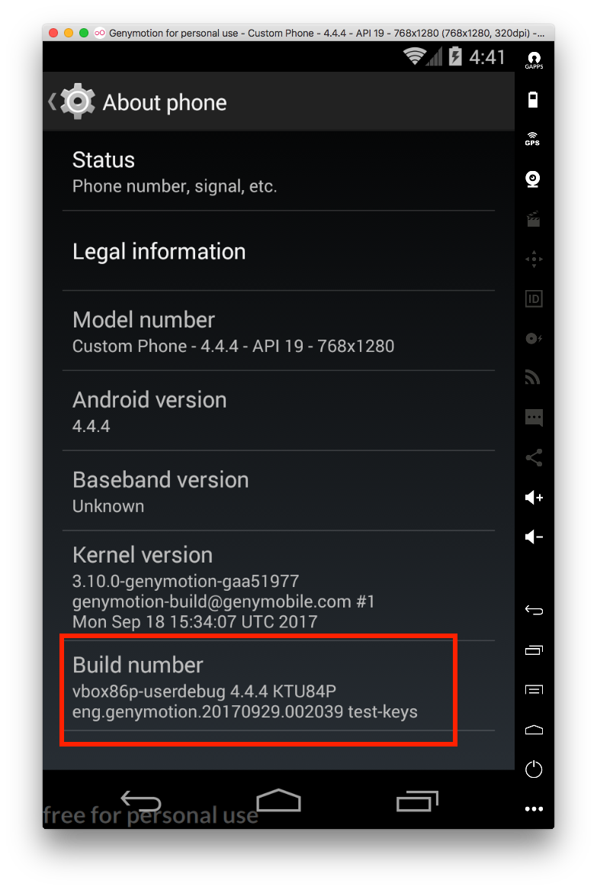
Activate Development mode
Press 5 times in a row on Build number

Slide 36
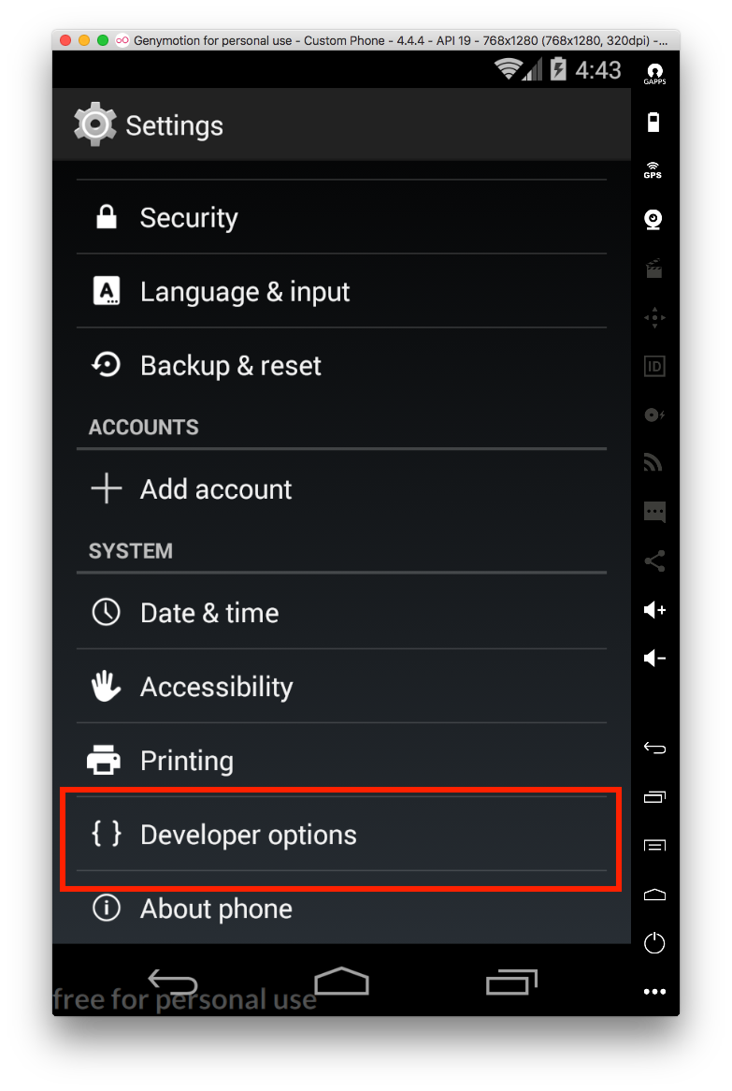

Slide 37
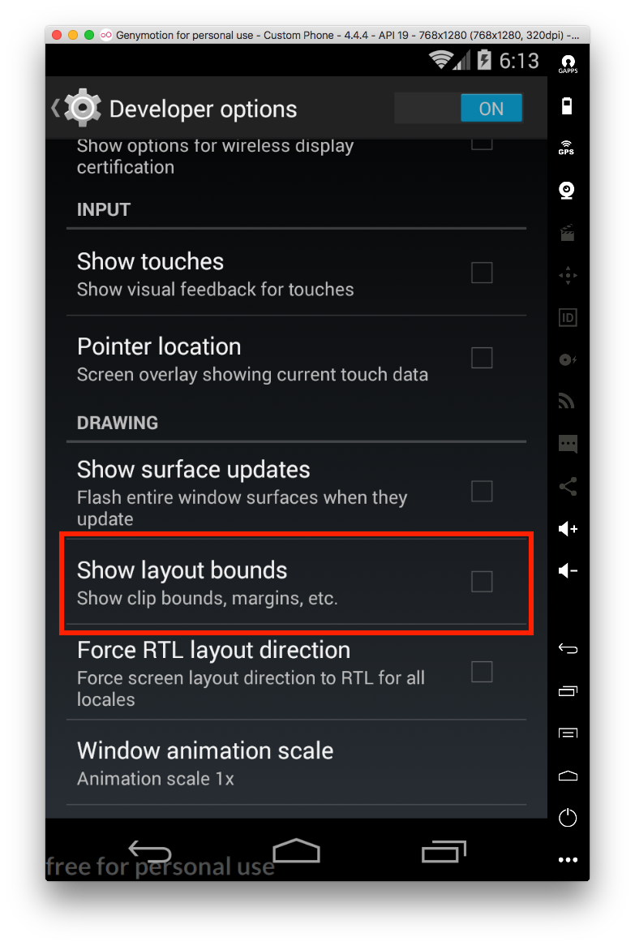
Show layout bounds in ANY app!

Slide 38
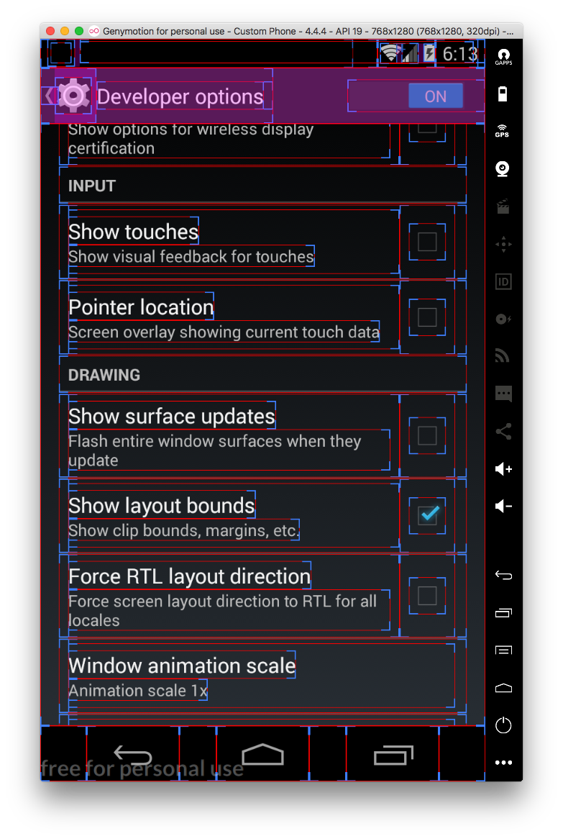
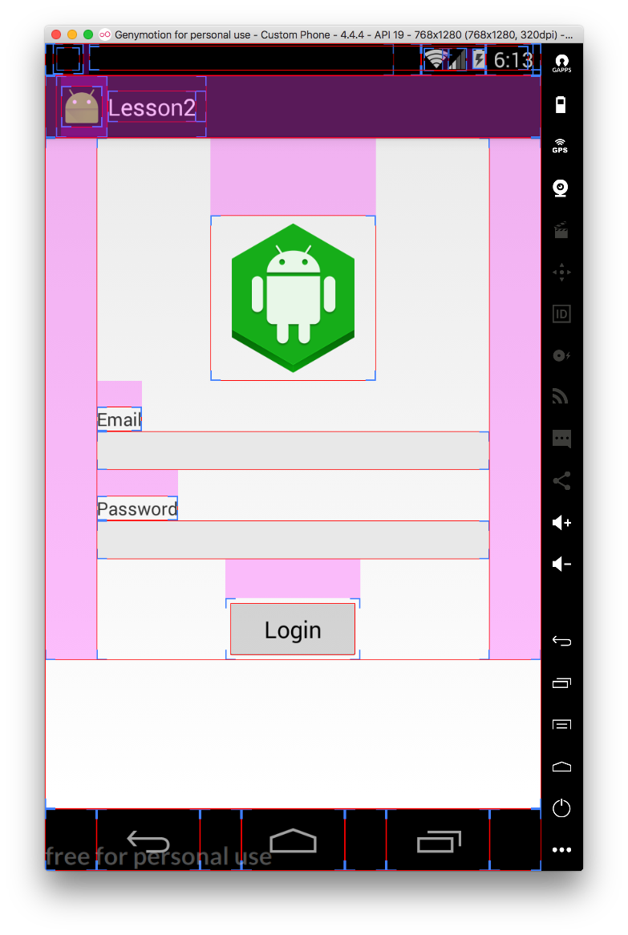

Slide 39
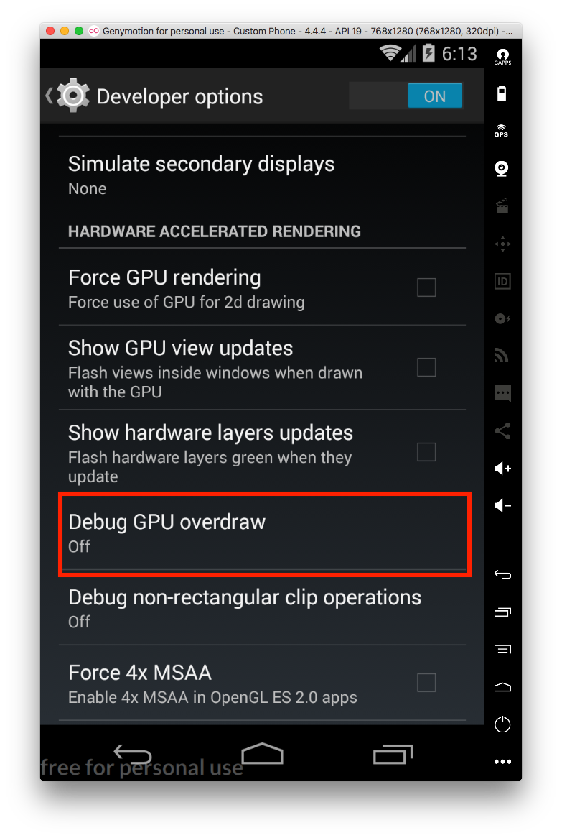
Draw cycles

Slide 40
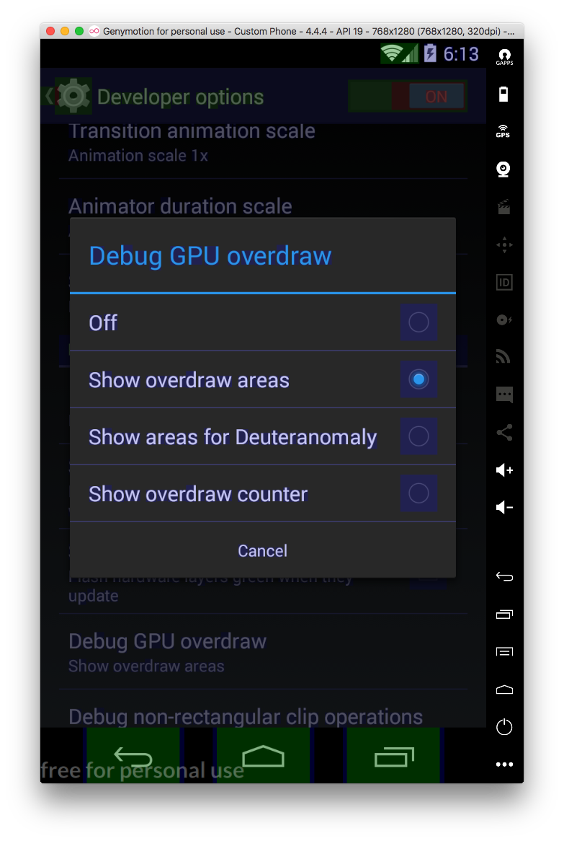

Slide 41
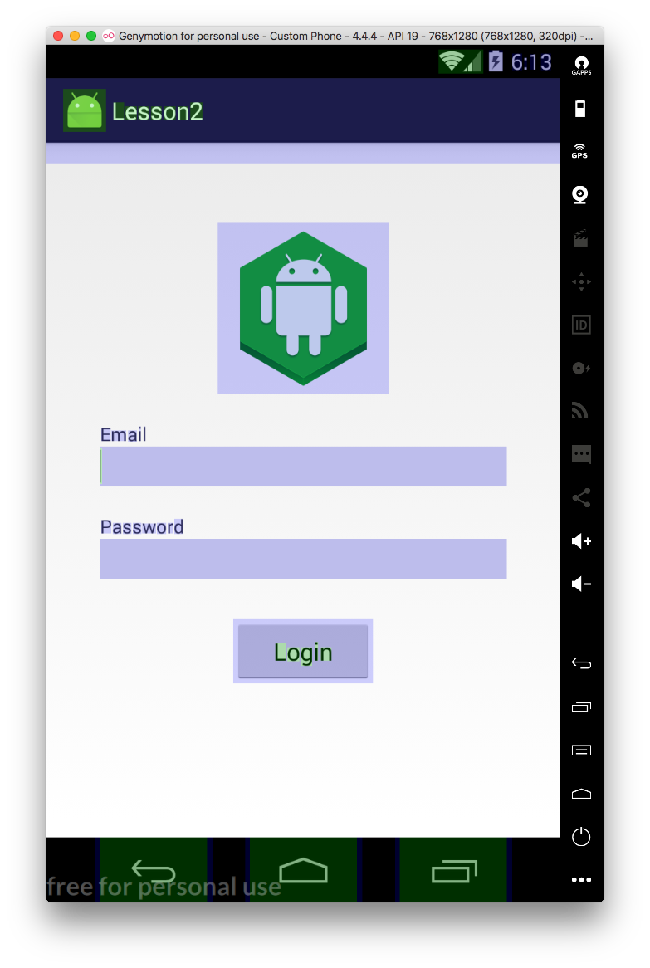
GOOD

Slide 42
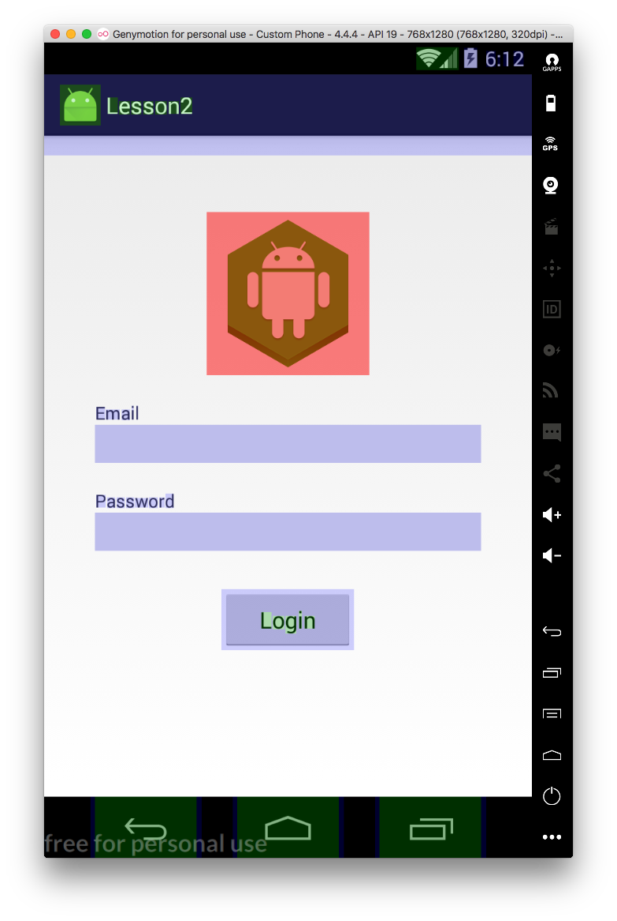
BAD

Slide 43
Homework
Create new Layout for a ItemGallery
Create a ViewHolder for ItemGallery
Display ItemGallery item in ListView
Create new activity for ItemGallery
Add GridView to that activity
Navigate on it on when ItemGallery pressed
Show image of all cars on it

